Slide 1
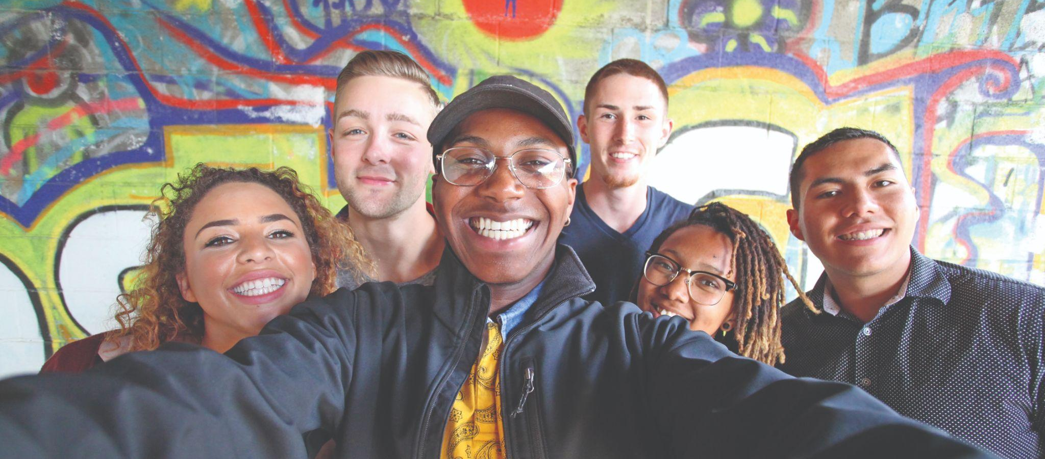

the national network for
young people in foster care
Notes:
FosterClub is the national network for young people in foster care.

Slide 2
what does it mean to
be in foster care?
Separation from family. New schools. Lost pets.
Government vehicles. Living with strangers.
Belongings gone. People asking questions. Stigma.
Court systems. Vulnerability. Grief. Uncertainty.
Notes:
What exactly does it mean to be in foster care? In short - it’s complicated.
Some young people credit foster care with saving their lives. Others wonder whether they should have been removed from their family in the first place. Many youth fall somewhere in between.
While recognizing foster care is a critical safety net, we know that being in the system brings its own unique challenges for children and youth.

Slide 3
WE BELIEVE:
With resources and connections, young people can make it and thrive....
And can help find a way
to make the foster care experience
a bit better for the next kid.
Notes:
We can all acknowledge that being in foster care can be tough. We believe, however, with resources and connections, young people can make it and thrive...
We ALSO believe - young people with lived experience in foster care can contribute to making the foster care experience better for their peers.
Before we get to HOW FosterClub does this - let’s back up for a moment to FosterClub’s origin story.

Slide 4
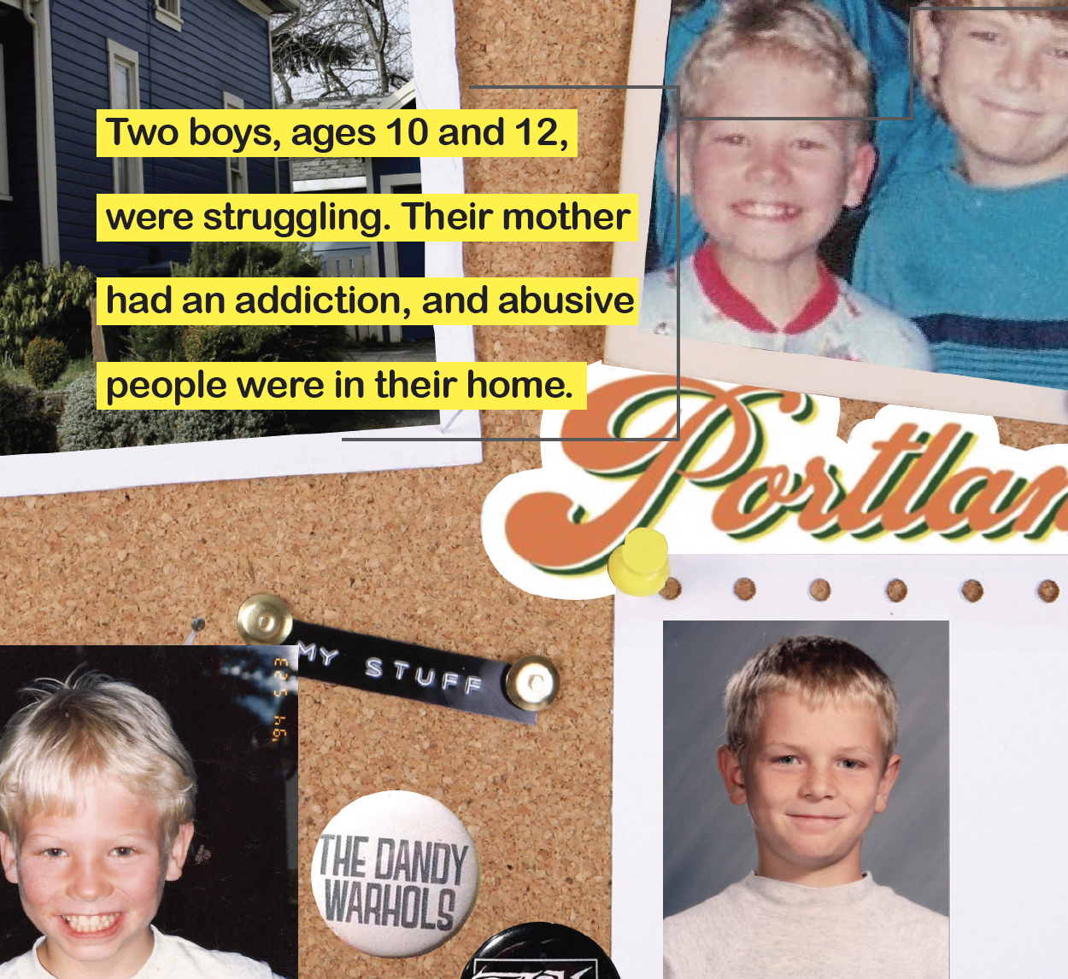
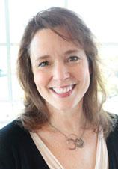
The story of FosterClub starts with
the story of
two boys.
Two boys, ages 10 and 12, were struggling. Their mother had an addiction, and abusive people were in their home.
Celeste Bodner
Founder
Notes:
The story of FosterClub starts with the story of two boys, ages 10 and 12, who were struggling. Their mother had an addiction, and abusive people were in their home.
To escape, and sometimes to find something to eat, they wandered their Portland, Oregon, neighborhood and found an empty shed to stay the night. It was 1996, and the shed belonged to a young couple Celeste and Jeff Bodner.
When child protective services removed the boys from their mother, the brothers identified the Bodners as the most reliable adults in their lives. Celeste and Jeff were asked to become foster parents.
Celeste found it odd that the boys received almost no information about foster care, while she and Jeff were supported with training, resources, and connected to a network of experienced foster parents.
The boys’ lives were in upheaval. When one of the boys suffered from anger and depression and struggled with traditional therapy, Celeste looked for a peer support network for him. She couldn’t find one.
This is how FosterClub came to be founded in the year 2000.

Slide 5
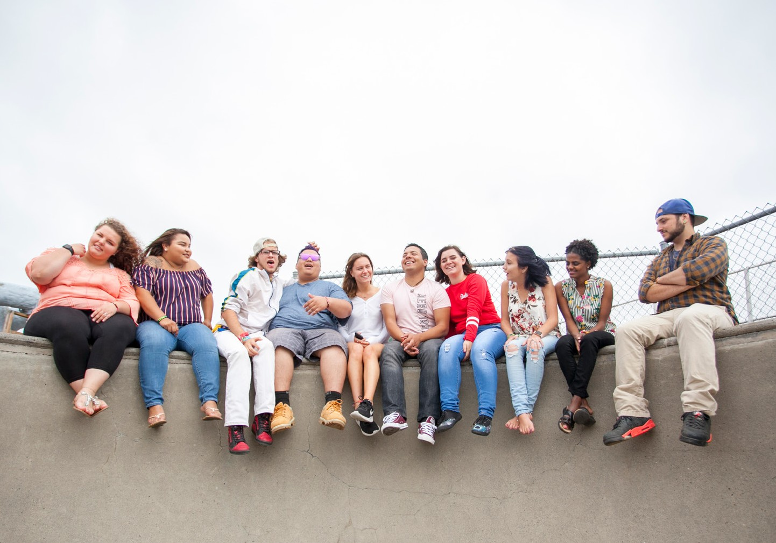
We created FosterClub for young people who experience foster care.
WHAT WE SET OUT TO DO
“I can’t imagine not having FosterClub in my life.”
Notes:
FosterClub was created for young people who experience foster care.
Founded in the year 2000, FosterClub has been on an over two-decades journey to explore our one critical challenge:
(next slide)

Slide 6
how to make
being in
foster care
not suck.
THE FOSTERCLUB WAY
Notes:
How to make being in foster care suck. Or - at least - not suck so much.
Again - we recognize that the foster care system provides a critical safety net - however, being in foster care is really a tough experience for most young people.
So - FosterClub has set out to improve the experience of being foster care by doing two things REALLY WELL:

Slide 7
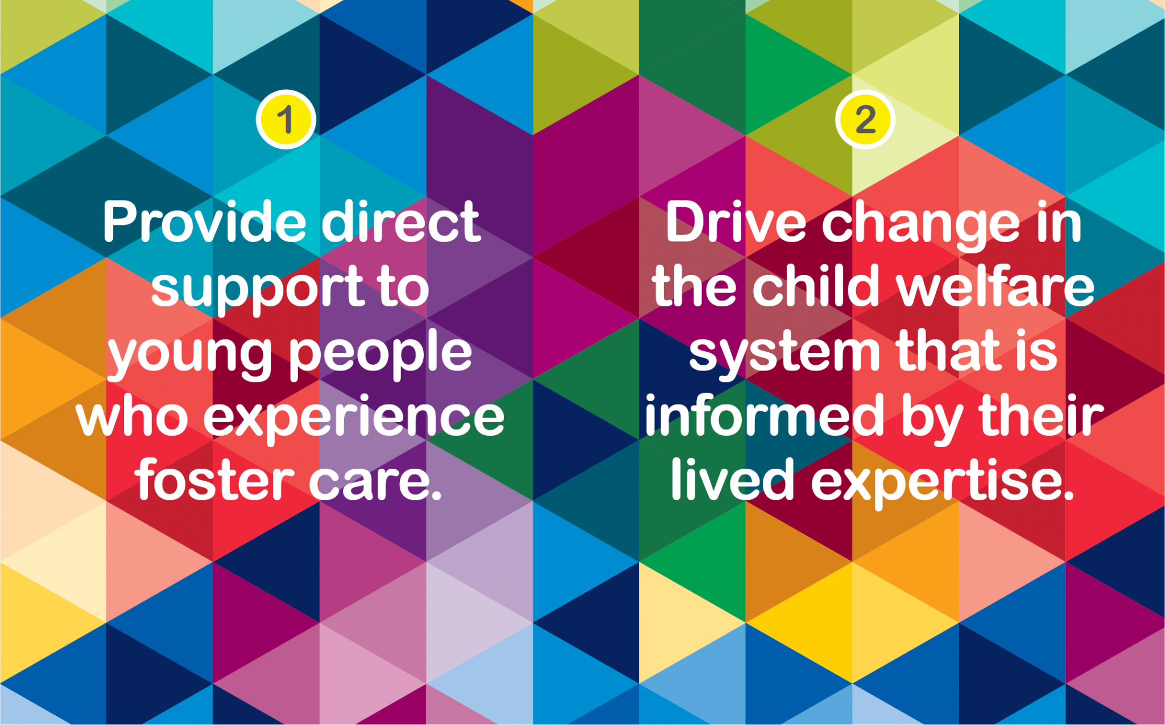
Notes:
First, we provide direct support to young people who experience foster care.
Secondly, FosterClub drives change in the child welfare system that is informed by young peoples’
lived experiences in the foster care system.

Slide 8
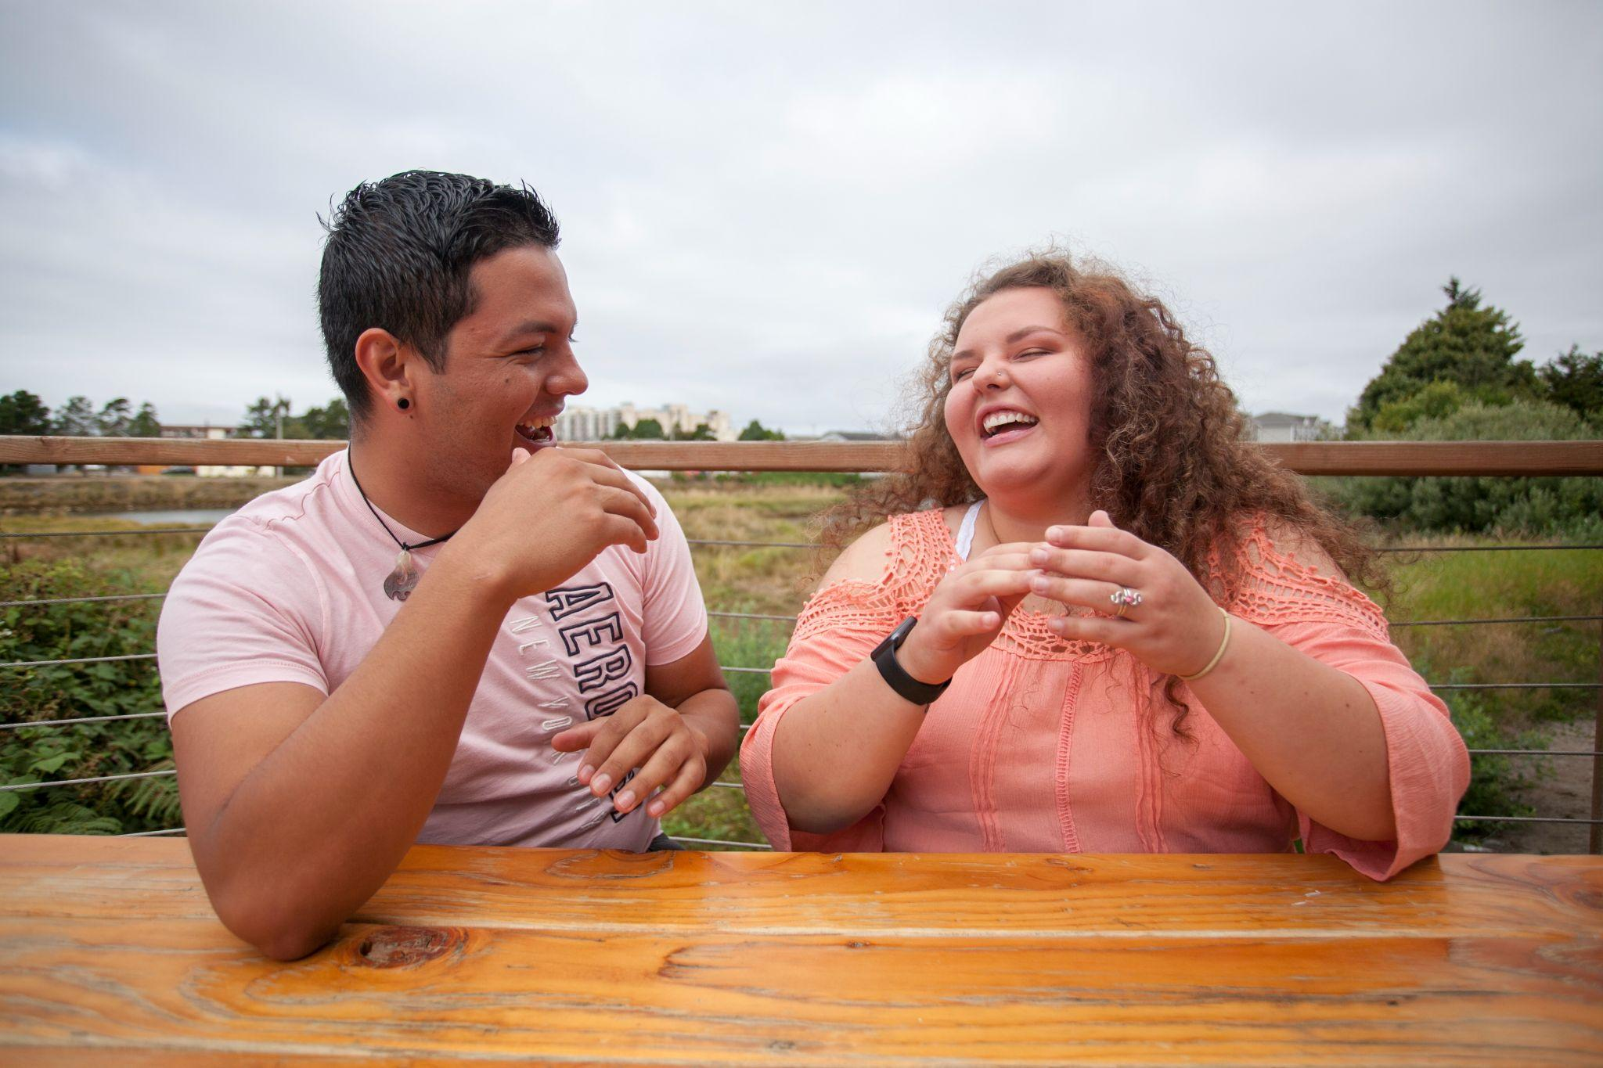
Youth Training
Resources and Referral
Peer Support and Mentoring
Direct Support to Young People
Notes:
For our first goal of providing DIRECT SUPPORT to young people who experience foster care, some of the activities we do to support young people include:
Providing training to help youth understand and navigate the foster care system, or to help older youth prepare to age out of foster care
Connect young people to resources that can help them succeed, like scholarships, internships, and pandemic relief funding
Peer mentors, who can help youth navigate what they are experiencing and also serve as an inspiration for younger youth
Opportunities to connect with other youth who experience foster care and gain peer support, through MeetUps, Camps, or Conferences designed specifically for young people in foster care.

Slide 9
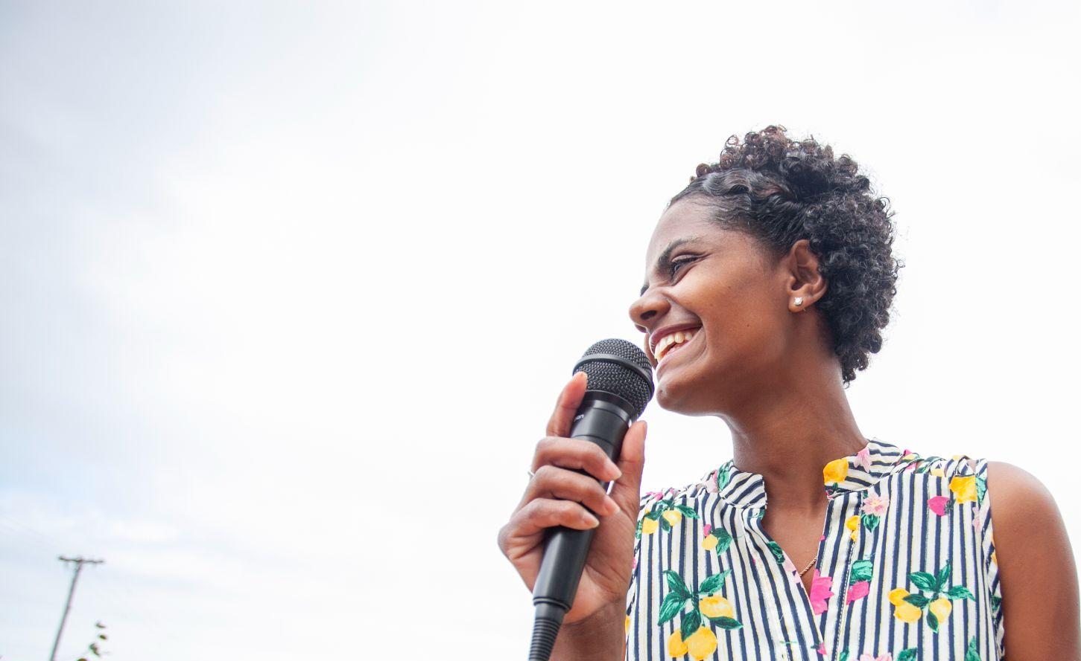
Public Policy
Practice Improvement
Public Awareness
2. System Change Informed
by Lived Experience
Notes:
For our second goal, our System Change activities fall into three categories:
Public policy - we ensure young people with Lived Experience have a seat at the table when decisions are being made about laws and funding that will impact their lives.
Our Practice Improvement efforts bring youth perspective to trainings for caseworkers and other child welfare professionals, foster parents and other caregivers, and professionals in other systems that impact foster youth (such as judicial, education, and health care)
Public awareness campaigns seek to educate the general public about the foster care experience. We believe that if people are more able to understand foster care through the eyes of those who experience it, the better we’ll be able to secure commitment and resources to support our cause.

Slide 10
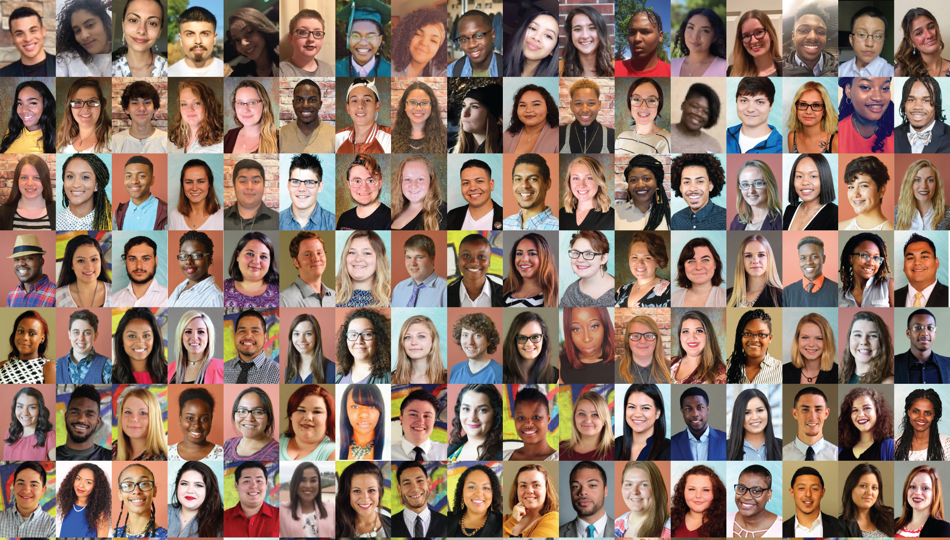
FosterClub’s work is carried out by a network of Lived Experience Leaders
LEx Leadership
Notes:
Here’s the magic - and this is the really important part:
All of FosterClub’s work is conducted through a partnership between our professional staff and Lived Experience Leaders - or LEx Leaders for short.
FosterClub’s LEx Leader network is a corps of approximately 200 volunteer service members. LEx Leaders step up and take on service opportunities through our two Program teams: Youth Services and System Change.
Each year, these inspirational LEx Leaders contribute more than 10,000 volunteer hours through their service at FosterClub. Their important work supports their peers still in foster care and is transforming how the child welfare system works.
And along the way, LEx Leaders gain transferable skills, build relationships and community, and often begin serious work to heal from the past trauma.

Slide 11
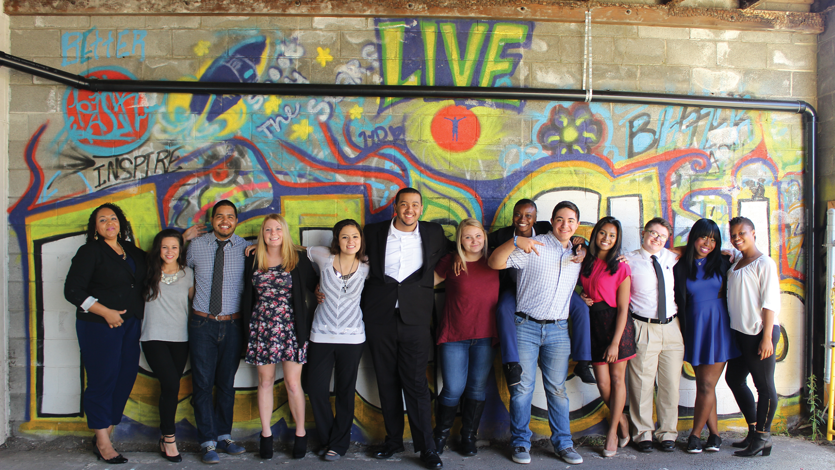
When young people have the support they need and opportunity to drive change in their life,
they become self-determined and do better.
OUR THEORY OF CHANGE:
When the system listens to young people, it does better.
Notes:
In summary - this is FosterClub’s two-part theory of change:
We believe that when young people have the support they need and opportunity to drive change in their life,
they become self-determined* and do better.
We also believe that when the system listens to young people, it does better.
Side note (for reference only - and to share if audience asks)
*Self determination theory is a broad framework that recognizes people are motivated to grow and change by three innate and universal psychological needs. This theory suggests that people are able to become self-determined when their needs for competence, connection, and autonomy are fulfilled. At FosterClub, self-determination is built through youth capacity-building in five distinct FosterClub SPARK domains (see www.FosterClub.com/SPARK)

Slide 12
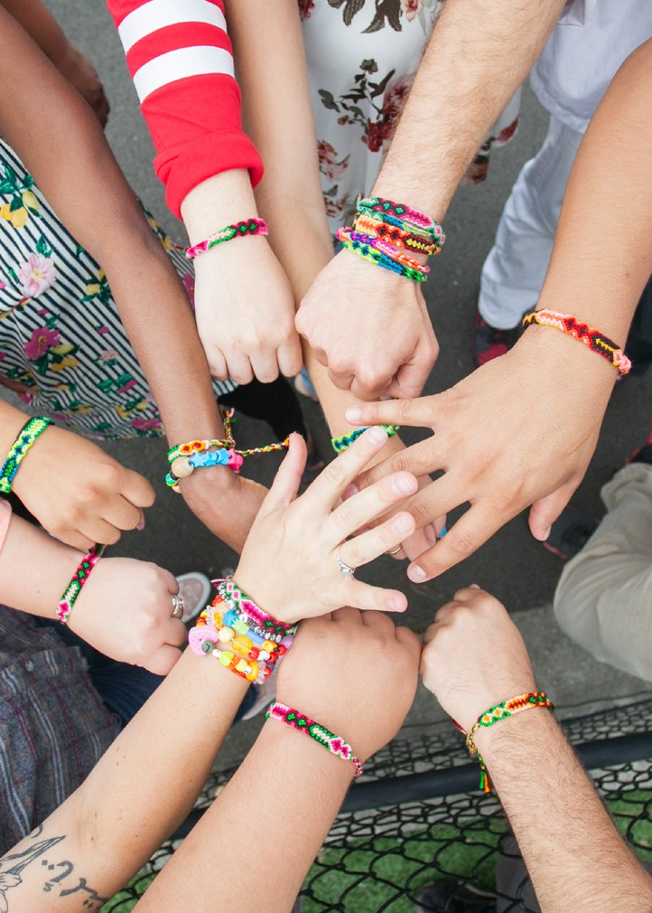
Together
we will
make things better in
foster care.
Learn more, get involved: www.fosterclub.org 503-717-1552
Notes:
We recognize we can not do this important work to improve foster care alone.
We are pleased to partner with a wide array of child welfare professionals, foster parents and caregivers, policymakers, researchers, national and community-based organizations, and concerned citizens.
Together we can make things better in foster care.

